Slide 1
Operators
Algorithms – set of procedures for solving a given set of problems, which always produces an answer.
  Luchin’s Water Jug Problem

Slide 2
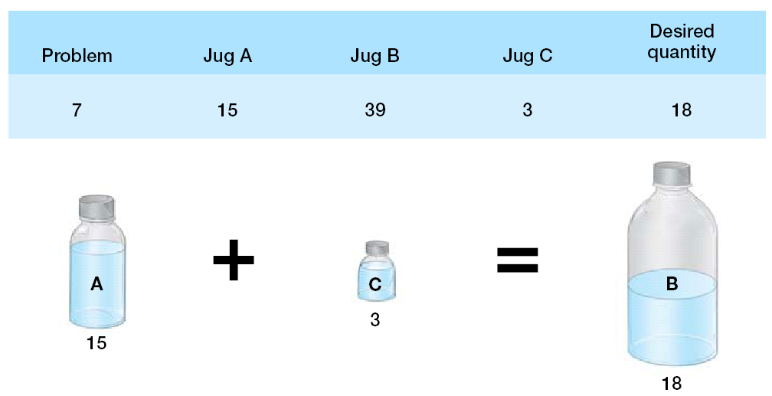

Slide 3
Operators
Problem: algorithms are SLOW.
Solution: Heuristics
  Rules of thumb that usually produce the correct answer but not always.

Slide 4

Other commonly used problem-solving heuristics are random search, hill climbing, and means–ends analysis.
The simplest and cognitively least demanding of these three is random search (also known as generate and test), which is essentially a process of trial and error: the problem solver randomly picks a move and tests to see whether the goal state is achieved.
More often, we use other, more knowledge-dependent heuristics, such as hill climbing, in which the problem solver looks one move ahead and chooses the move that most closely resembles the goal state.

Slide 5
Hill climbing –
  Can lead you astray!
Example
Fox, rabbit, carrot
  Get them all across the river.
  Rules:
    Only two things in the boat at once.
    Can’t have two things that will eat each other in the boat at once.
    Can’t float back an empty boat.

Slide 6
Back-up avoidance – people don’t like to undo any steps previously taken
  As we can see from the fox problem and from the Tower of Hanoi problem.

Slide 7
A more demanding, but more successful, strategy is means–ends analysis, in which the problem is broken into subproblems.
A second behavioral approach, developed in the 1970s, is verbal protocol analysis, which is the analysis of the thought process of the problem solver as described aloud by the solver in the course of working on the problem.
A third approach looks to computers, building programs that embody the strategy that people presumably use to solve a problem, and then comparing the computer output to the moves made by a person.

Slide 8
Means – Ends analysis:
  Tried the tower with an MRI machine!
  The prefrontal cortex was involved with the steps that require backing up.
  People with damage to this area have a hard time solving problems that require backing up.

Slide 9
More goals = more brain activation
  Therefore activation in the prefrontal cortex decreases as you get to the solution of the problem.

Slide 10

In analogical reasoning, rather than beginning from scratch using heuristics such as means–ends analysis, you try to think of a problem with similar characteristics that has been solved before and use or adapt that solution in the present instance.
Analogical reasoning is often a process of comparison, using knowledge from one relatively known domain (“the source,” such as the bicycle thieves in the earlier situation) and applying it to another domain (“the target,” or your locked computer)

Slide 11
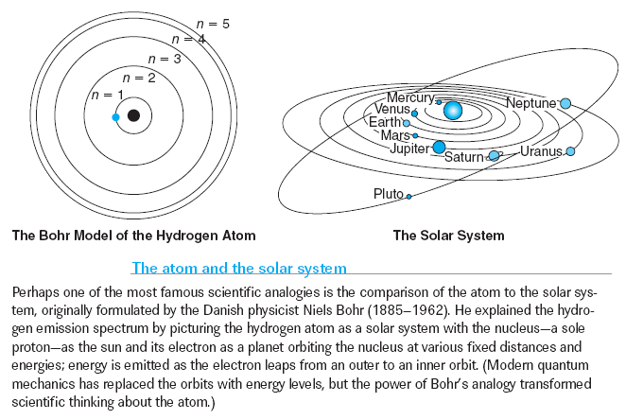
ANALOGICAL REASONING
Chapter 10

Slide 12
Parts:
  Retrieval – holding problem in working memory while pulling up similar problem from LTM
  Mapping – putting target problem and other problem together
  Evaluation – deciding if analogy works
  Abstraction – isolating the structure shared by the source and target.
  Predictions: developing hypotheses about the behavior or characteristics of the target from what is known about the source

Slide 13

Military Problem
A small country was ruled from a strong fortress by a dictator. The
fortress was situated in the middle of the country, surrounded by farms
and villages. Many roads led to the fortress through the countryside. A
rebel general vowed to capture the fortress. The general knew that an
attack by his entire army would capture the fortress. He gathered his
army at the head of one of the roads, ready to launch a full-scale direct
attack. However, the general then learned that the dictator had planted
mines on each of the roads. The mines were set so that small bodies of
men could pass over them safely, since the dictator needed to move his
troops and workers to and from the fortress. However, any large force
would detonate the mines. Not only would this blow up the road, but it
would also destroy many neighboring villages. It therefore seemed
impossible to capture the fortress.

Slide 14
Suppose you are a doctor faced with a patient who has a malignant tumor in his stomach. It is impossible to operate on the patient but unless the tumor is destroyed the patient will die. There is a kind of laser that can be used to destroy the tumor. If the laser reaches the tumor all at once at a sufficiently high intensity, the tumor will be destroyed. Unfortunately, at this intensity the healthy tissue that the laser passes through on the way to the tumor will also be destroyed. At lower intensities the lasers are harmless to healthy tissue. How can you destroy the tumor with out killing the patient?

Slide 15
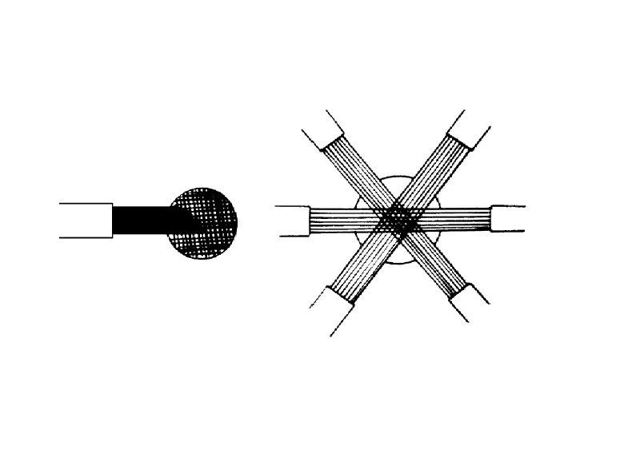

Slide 16

Problems with Analogy
  People do not often notice the relationships between problems
  Have to be explicitly told
  Often use superficial surface facts to solve.

Slide 17
Analogy and the Brain
  Study using Raven’s Progressive Matrices
  Mostly prefrontal cortex
  This is why kids can’t do analogy very well, prefrontal cortex takes a while to develop.

Slide 18
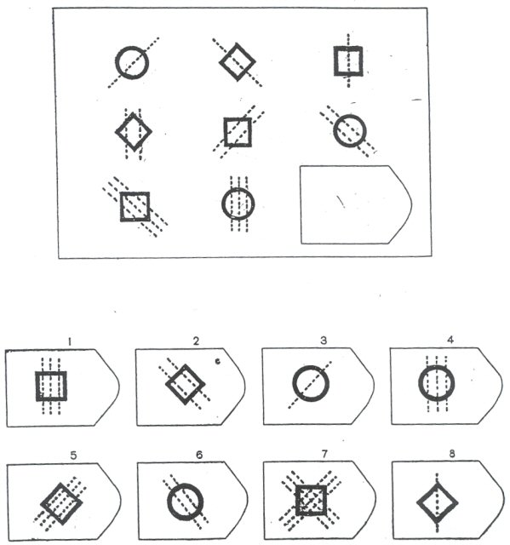


Slide 19
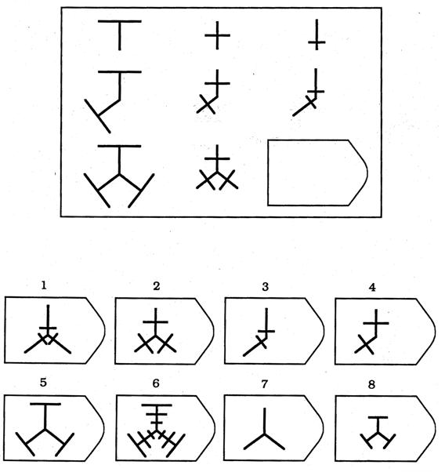

Slide 20
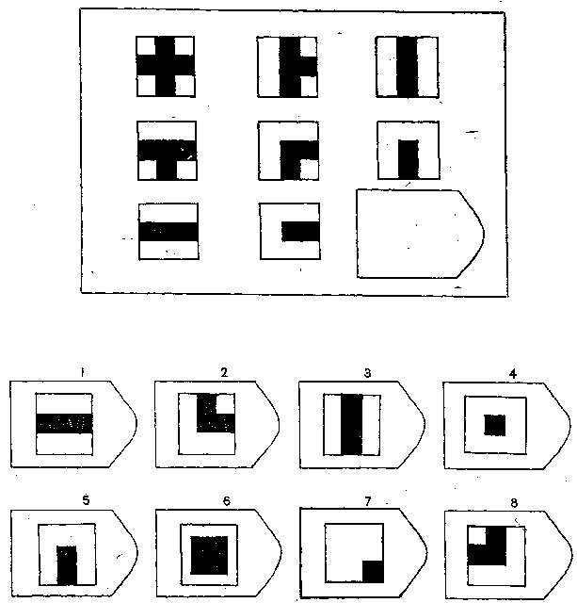

Slide 21
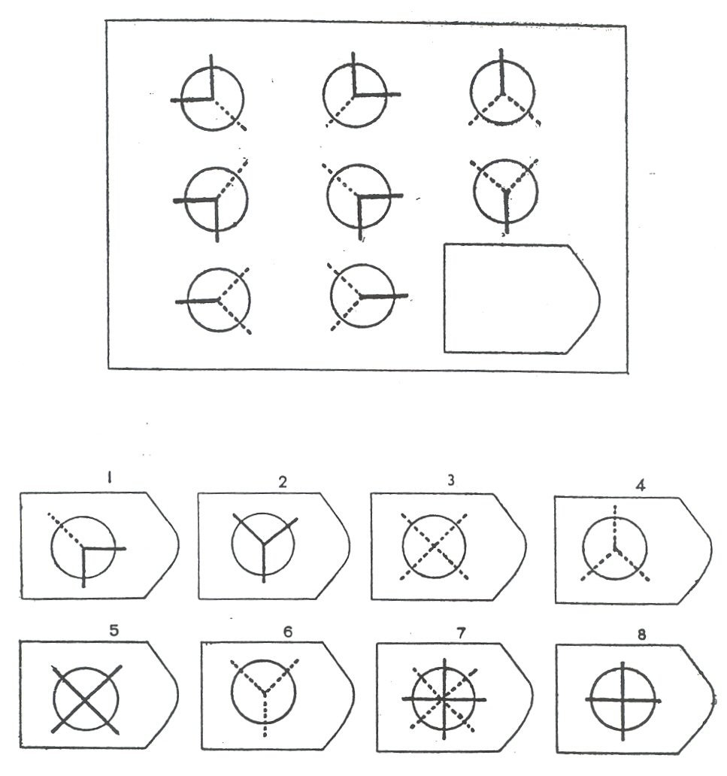

Slide 22

One issue with problem solving is problem representation:
  How do you deal with the information you have to solve the problem?
  What if you are not thinking about the information the right way?
  What if you get stuck?

Slide 23
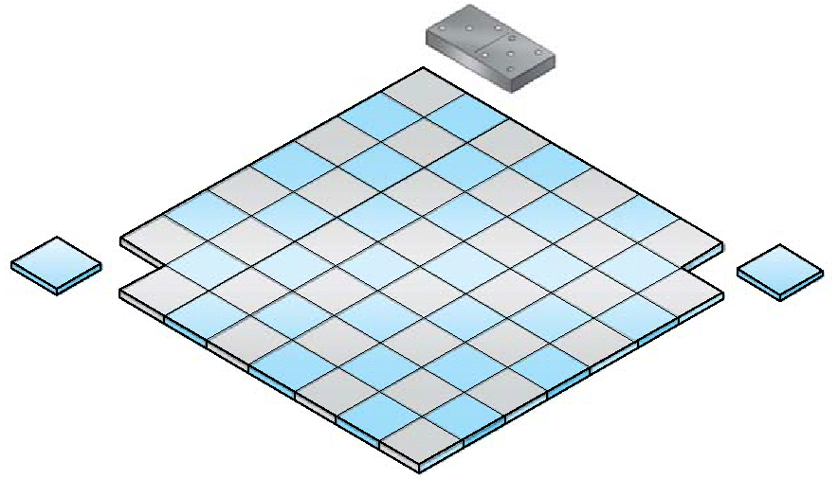

Slide 24

The Mutilated Checkerboard problem cannot be solved.
  Why not?

Slide 25
Must cover one black and red, just not any two squares.
  32 red squares and 30 black squares, instead of 32 and 32.

Slide 26
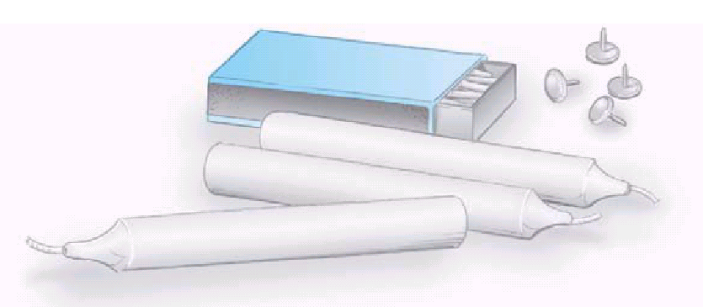

Slide 27
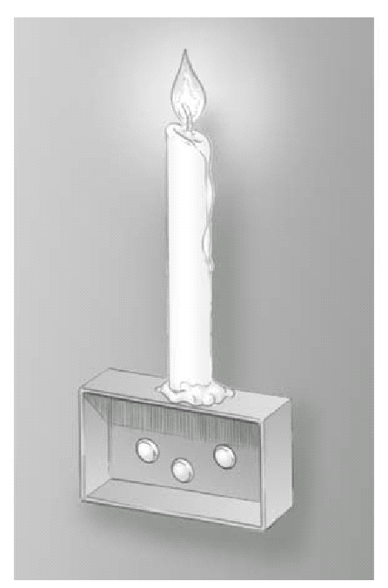

Slide 28
Two strings having from a ceiling are to be tied together, but they are so far apart that the you cannot grasp both at once.
All you have is a chair and a pair of pliers.
How do you do it?

Slide 29
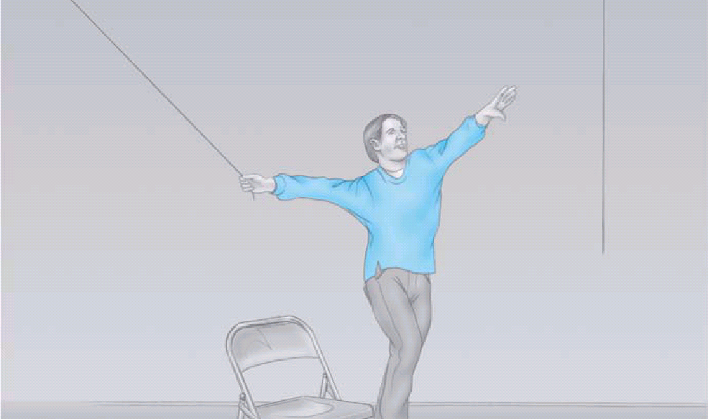

Slide 30
Functional fixedness
  The tendency to see objects only as serving conventional problem solving functions an thus failing to see that they can serve novel functions.

Slide 31
Set effects – when you get stuck solving a problem the same way over and over.
  These happen because the operators to solve that type of problem are well learned.

Slide 32
What is greater than God
More evil than the Devil
The poor have it
The rich want it
And if you eat it you’ll die?

